Slide 1
Temperature Activated Lamp
ECE 2360 Final Project
Team Names:
Christian Coulibaly, Emmanuel Key

Slide 2
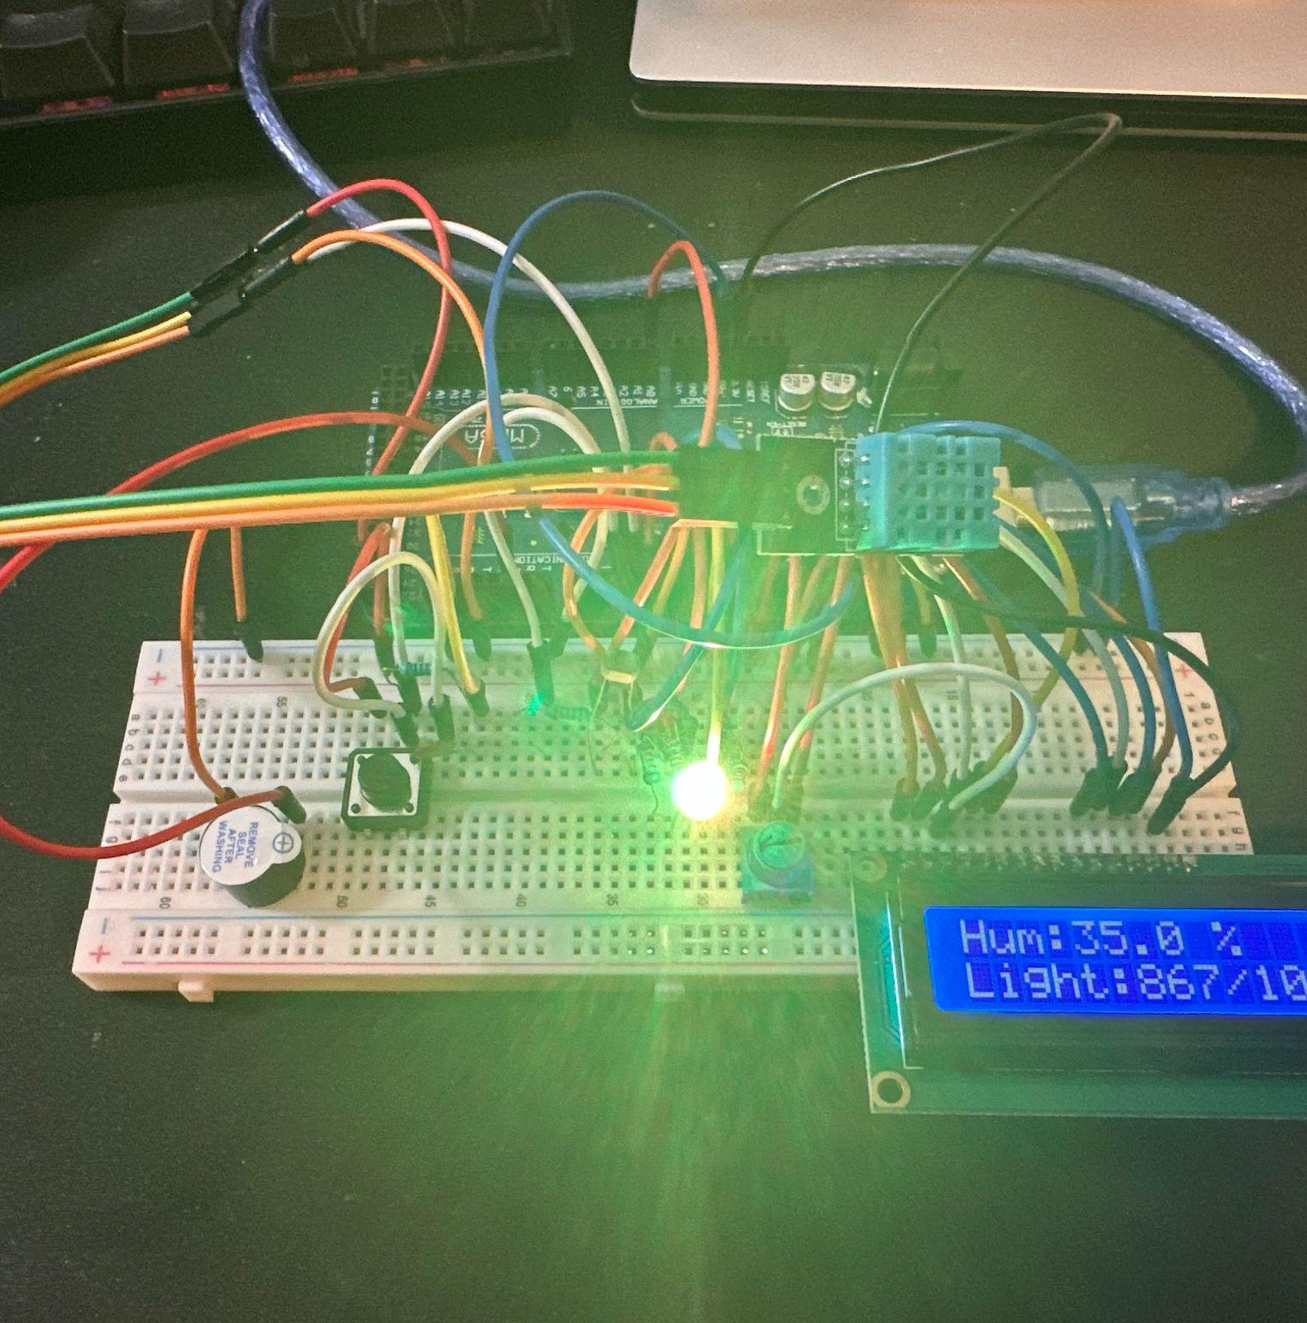
Introduction
Our project is a temperature-activated lamp designed to sit by a window, using a DHT sensor outside to interpret weather conditions displayed via an RGB LED and LCD. Additionally, it features a buzzer alert system, ensuring we’re notified of any components are malfunctioning.

Slide 3
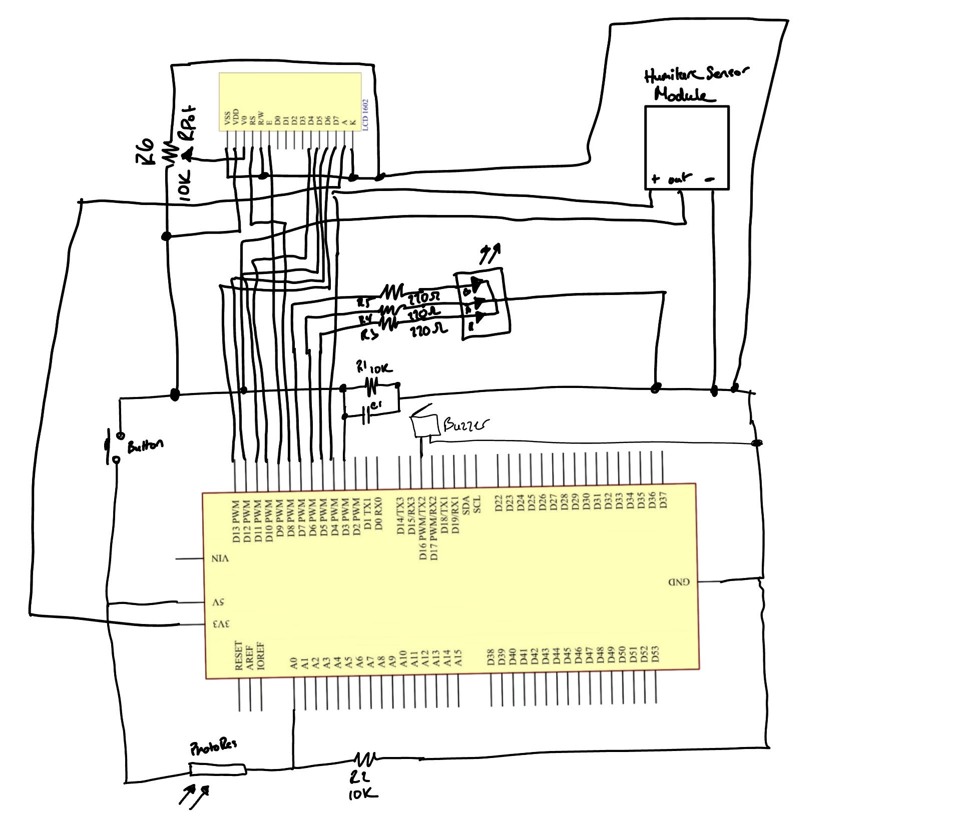
Schematic Diagram

Slide 4
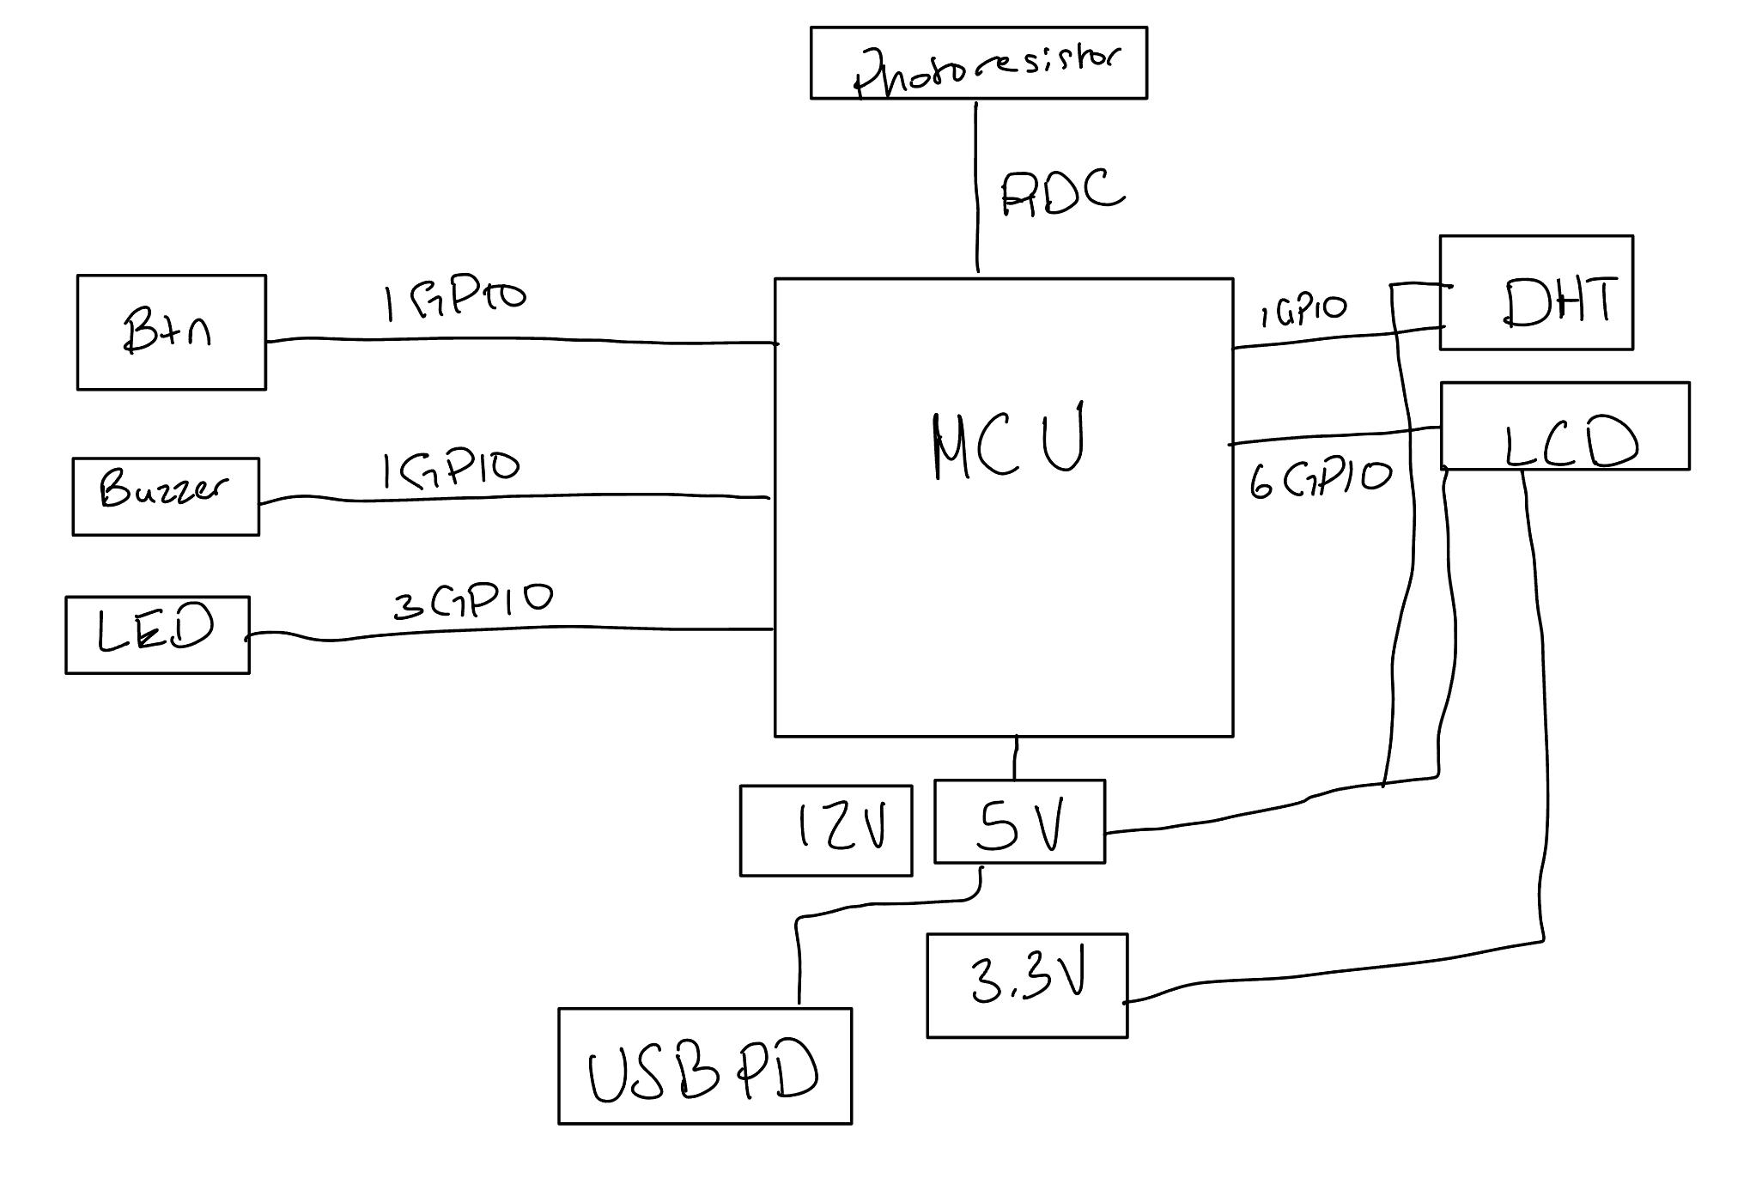
Block Diagram

Slide 5
Design discussion
Future:
We could add a battery, or a permanent power source over the USB cable.
We could also add a fan that cools the area once the temperature meets a certain threshold.
Issues:
We had a tough time getting the LCD working, but we were able to fix it by refreshing our libraries.
We also had a bad time with the button and getting it to accurately turn on and off the LED. We fixed it by changing the debounce delay.

Slide 6
12 Elements
RGB LED
Light Sensor
LCD
Used to indicate temperature
Used to detect light levels
Gives a more verbose summary of inputs
MCU
Breadboard
Resistors
Processes inputs and outputs
Allows all elements to interact
Limits current to and from elements

Slide 7
12 Elements
Temp Sensor
On/Off Button
GPIO/PWM
Used to indicate temperature
Used to detect help light levels
Allows MCU to understand sensors
Buzzer
Capacitor
Potentiometer
Used to warn of a malfuntion
Used to help read button input
Allows for variable resistance for LCD

Slide 8
Conclusion
What we learned
Suggestions
During this project, we learned more about different components we did not get the chance to fully learn about during the course. We also used GitHub to share code, which was a learning point as well.
Though we thoroughly enjoyed this project, it would have been cool to be given a list of problems to choose from, and we create something that solves that problem.

Slide 9
Sources
All of our sources came from our lab documentation.
https://docs.sunfounder.com/projects/uno-mega-kit/en/latest/mega2560/humiture_sensor.html
https://docs.sunfounder.com/projects/uno-mega-kit/en/latest/mega2560/lcd1602.html
https://docs.sunfounder.com/projects/uno-mega-kit/en/latest/mega2560/photo_resistor.html
https://docs.sunfounder.com/projects/uno-mega-kit/en/latest/mega2560/controlling_led_by_button.html

Slide 10
Thank You!!

